Slide 1

Stock Sentiment Analysis December 23, 2021
Northwestern Fintech Project 1
Team Members: Conor Hunt, Denise Franta, Joshua Neft, Orkhan Garajayev, Raja Abhishek

Slide 2
Motivation and Summary
Hypothesis:
Prevailing sentiment influences stock prices and can be analyzed to better understand financial market movement
What We Did:
Analyzed daily price data of 10 stocks across 5 sectors from 1/1/2006 to 10/31/2020 and determined correlations with chosen keyword trends
Useful Knowledge:
Bollinger Bands to contextualize price movements
Democratization of retail trading in recent years
Sentiment trading exists
General Findings:
Interpretable correlations between keywords and financial stock prices
Weak or no correlation for most other sectors
“Recession” as the strongest keyword

Slide 3
Questions and Data
Questions
Key Words
Stocks
What effect google search words had on the volatility of stock price?
Does searched key word affect industries differently?
Positive and negative economic sentiment words were chosen. Words like loss, downturn, unemployment, recession were used for negative sentiment. Words we considered to be positive for consumers spending like gift, jewelry and restaurant. Lastly commodity words -oil, gold were used in addition to buy stock and sell stock.
Tech Sector
Microsoft
Apple
Financial Sector
J P Morgan
Bank of America
Pharma
Pfizer
Johnson & Johnson
Consumer Goods
Coke
Campbell Soups
Industrial
Honeywell
Caterpillar
Data
A 15-year timeframe was selected for our data to show periods of volatility (2008 financial crisis & 2020 COVID crisis) with 10 years stability in between.
Data Source
Yfinance – Daily Stock Price
Pytrend – Google search data

Slide 4

Data Exploration

Slide 5
Data pull, cleaning and merging process
Google trend keyword search
Normalization of trend data
Correlation between searched keyword
Remove highly correlated keywords
Merge data frames
Remove nulls
Yfinance stock price
Daily Return

Slide 6
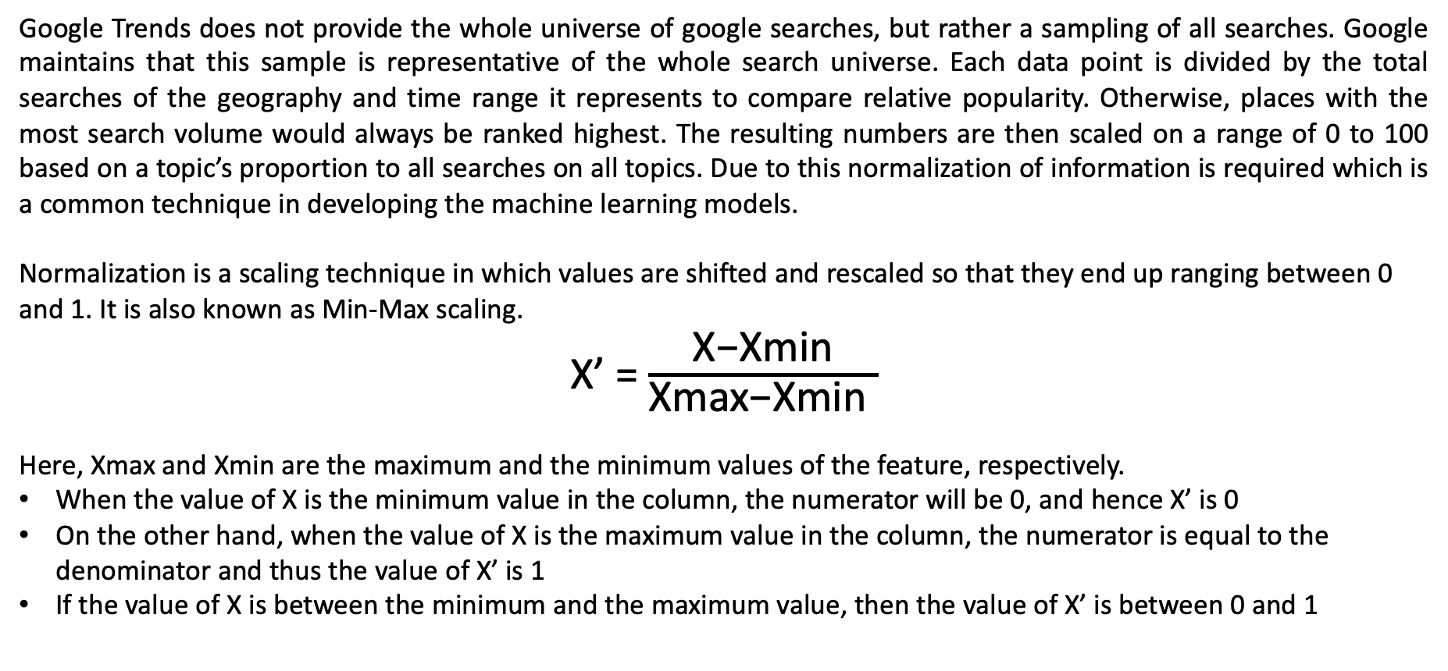
Normalization
Google Trends does not provide the whole universe of google searches, but rather a sampling of all searches. Google maintains that this sample is representative of the whole search universe. Each data point is divided by the total searches of the geography and time range it represents to compare relative popularity. Otherwise, places with the most search volume would always be ranked highest. The resulting numbers are then scaled on a range of 0 to 100 based on a topic’s proportion to all searches on all topics. Due to this normalization of information is required which is a common technique in developing the machine learning models.
Normalization is a scaling technique in which values are shifted and rescaled so that they end up ranging between 0 and 1. It is also known as Min-Max scaling.
X’ = $\frac{\text{X}\text{−}\text{Xmin}}{\text{X}\text{max}\text{−}\text{Xmin} }$
Here, Xmax and Xmin are the maximum and the minimum values of the feature, respectively.
When the value of X is the minimum value in the column, the numerator will be 0, and hence X’ is 0
On the other hand, when the value of X is the maximum value in the column, the numerator is equal to the denominator and thus the value of X’ is 1
If the value of X is between the minimum and the maximum value, then the value of X’ is between 0 and 1

Slide 7
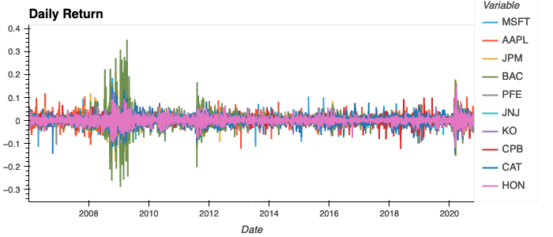
Data Exploration: Uncertain times increases volatility
Stock prices shows higher degree of volatility during uncertain times
2007-08 economic crisis
European sovereign debt crisis (Spain and Italy)
Covid impact
A
B
C
During 2007-08 economic crisis and European sovereign debt crisis, financial stocks were showing higher degree of volatility compared to covid time

Slide 8
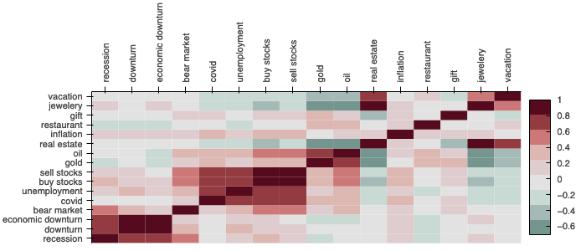
Data Exploration: Keywords are highly correlated
Economic downturn, downturn and recession are similar, hence not surprised that they have very high positive correlation
Sell stocks, buy stocks, unemployment and covid have high positive correlation
Oil and gold are positively correlated with each other, however negatively correlated real estate search
Considered one key word from highly correlated pools for the final analysis
C
B
A

Slide 9
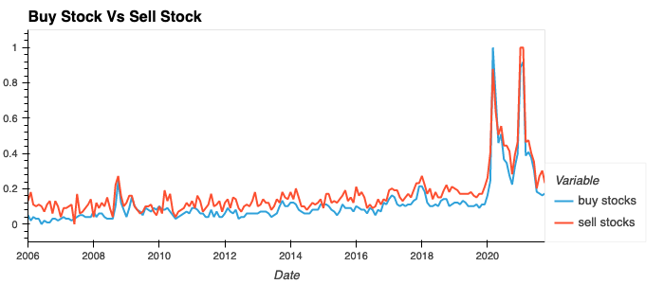
Data Exploration: Trending of buy stock and sell stock
Search of buy and sell stock move with each other, and are positively correlated

Slide 10
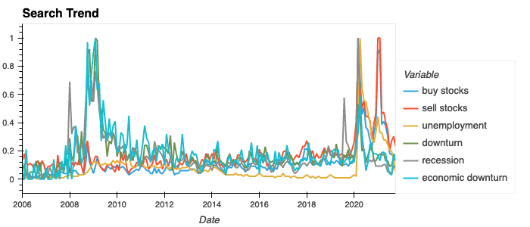
Data Exploration: Shift in search trend
During 2007-08 economic crisis, recession, downturn and economic downturn were key searches however during covid period buy stocks, sell stocks and unemployment are trending words

Slide 11
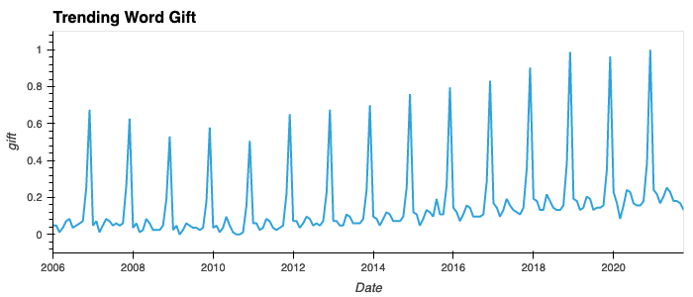
Data Exploration: Is search seasonal?
Trending of keyword gift is seasonal as it peaks every December before Christmas

Slide 12

Data Analysis

Slide 13
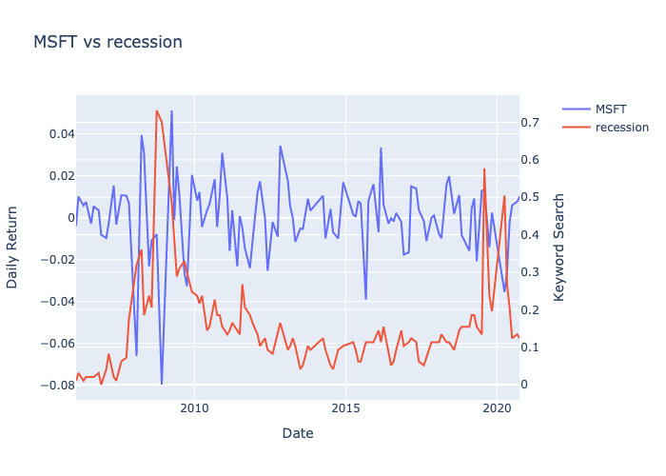
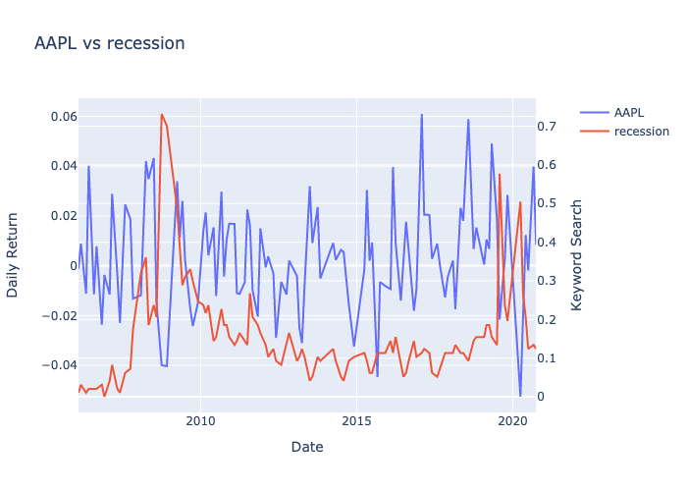
Data Analysis: Recession Vs Tech Stocks
Volatility in tech stock’s daily return was aligned during the 2007-08 economic crisis but showing weaker relation during remaining period

Slide 14
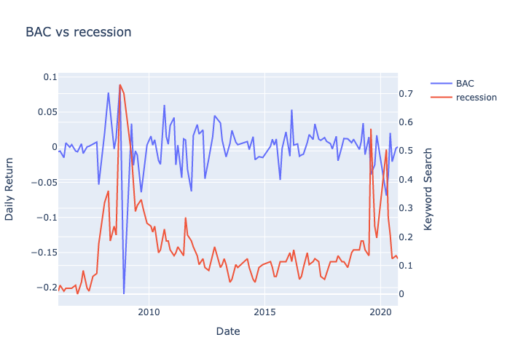
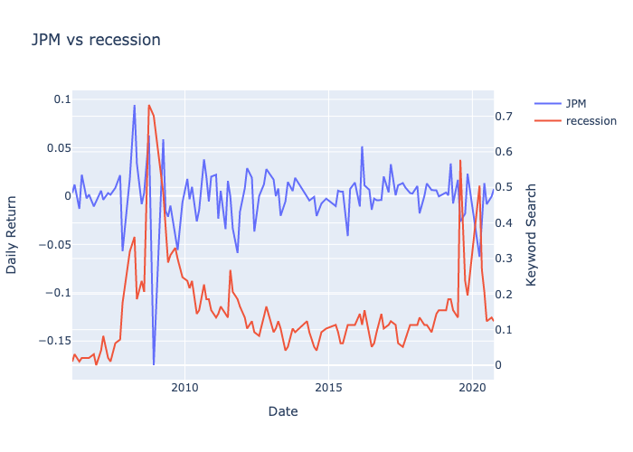
Data Analysis: Recession Vs Financial Stocks
Volatility in financial stock’s daily return was aligned during the 2007-08 economic crisis but showing weaker relation during remaining period

Slide 15
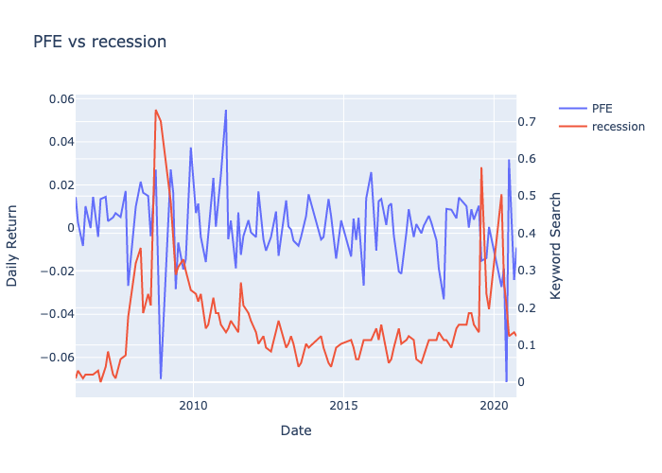
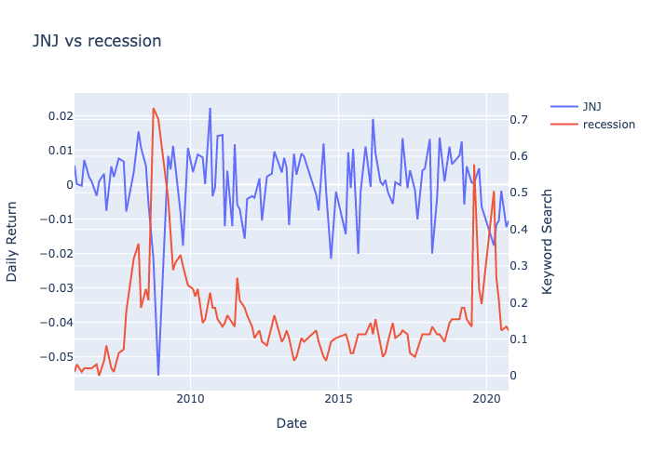
Data Analysis: Recession Vs Pharma Stocks
Volatility in pharma stock’s daily return was aligned during the 2007-08 economic crisis but showing weaker relation during remaining period

Slide 16
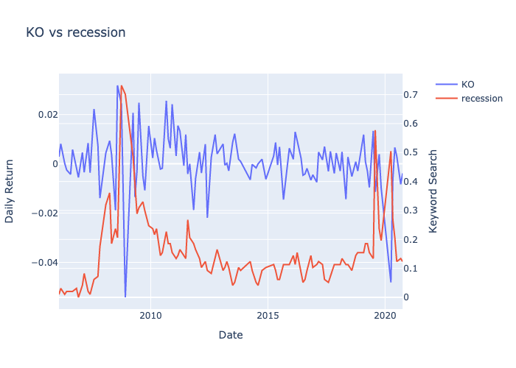
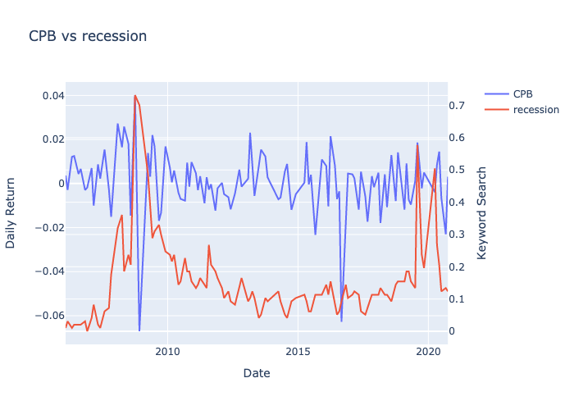
Data Analysis: Recession Vs Consumer Goods
Volatility in consumer goods stock’s daily return was aligned during the 2007-08 economic crisis but showing weaker relation during remaining period

Slide 17
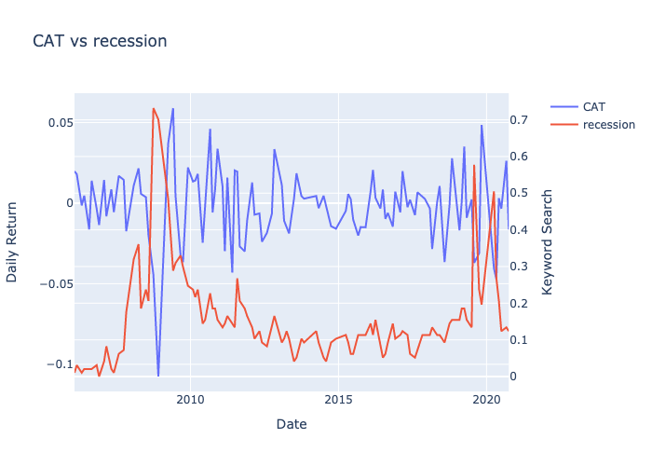
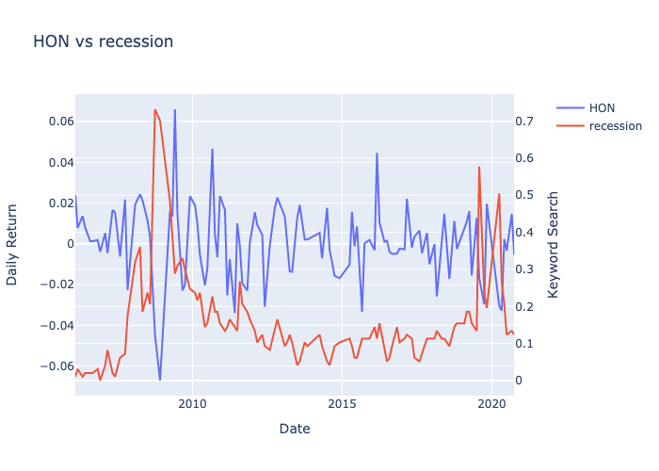
Data Analysis: Recession Vs Industrial Stocks
Volatility in industrial stock’s daily return was aligned during the 2007-08 economic crisis but showing weaker relation during remaining period

Slide 18
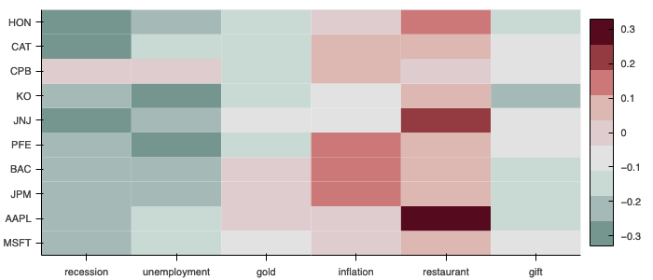
Conclusion
Daily return of the stock price depends on multiple factors such as profits, revenue, product launch, forward looking guidance, regulations etc. Hence keywords alone will not be able to explain the inherent volatility which is evident from the weak correlation.

Slide 19
Postmortem

Slide 20
Challenges
Data pull from yfinance
Challenge– Pulling multiple stock data in one go from yfinance was not producing the correct output as stock price of one stock was getting reflected under another ticker.
Solution - Pulled the data individually for each stock and appended in final data set
Google Trend Data
Challenge – Google Trends does not provide the whole universe of google searches, but rather a sampling of all searches. Google maintains that this sample is representative of the whole search universe. Each data point is divided by the total searches of the geography and time range it represents to compare relative popularity. Otherwise, places with the most search volume would always be ranked highest. The resulting numbers are then scaled on a range of 0 to 100 based on a topic’s proportion to all searches on all topics. Due to this pulling data for same keyword with different combinations were producing the different results.
Solution - Pulled the data individually for each key word and normalized it using Min-Max scaling which is a normal procedure in model development process

Slide 21
Additional Questions
Is weaker correlation due to consideration of historical information when other search engines (like Yahoo) were dominating the market compared to Google?
How would trending keyword help in analyzing the sentiment if combined with individual stock related information?
Will put to call ratio be better in predicting the sentiment?
Why apple daily return was showing a better correlation with restaurant keyword compared to other keywords?

Slide 22

Appendix

Slide 23
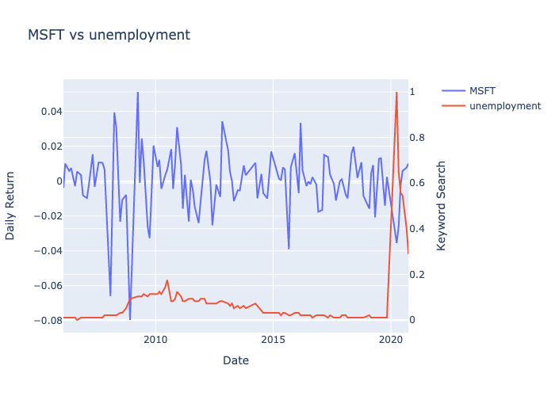
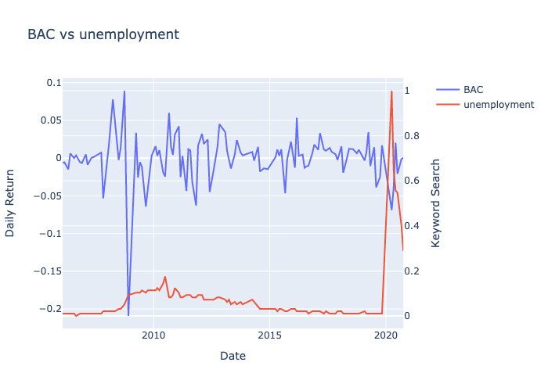
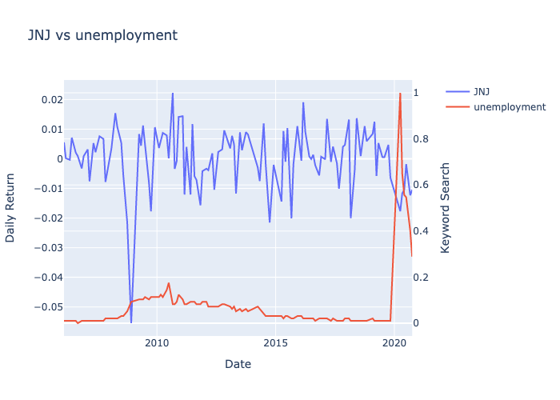
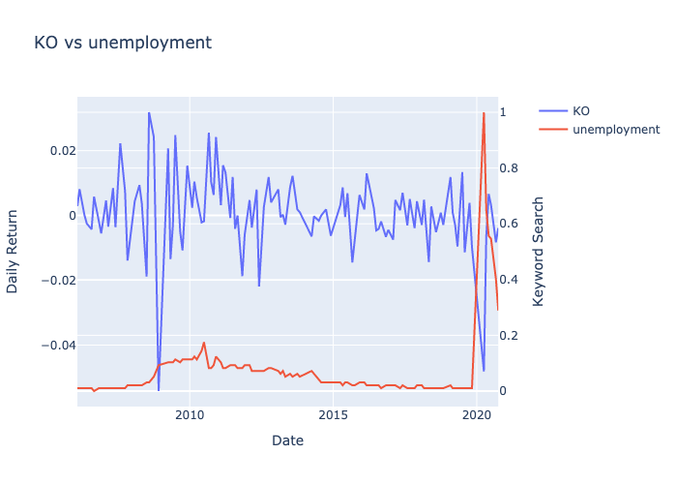
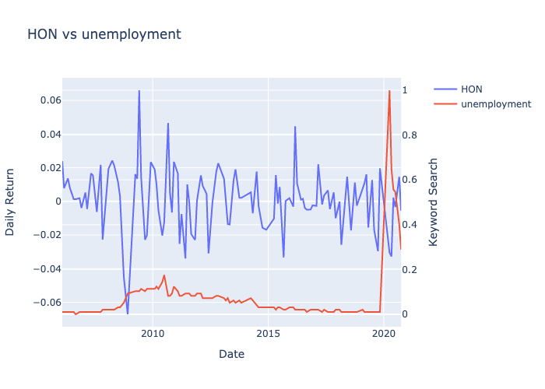
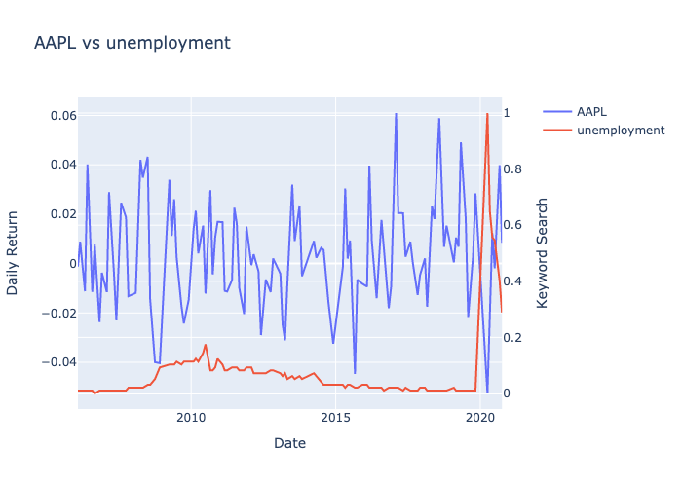
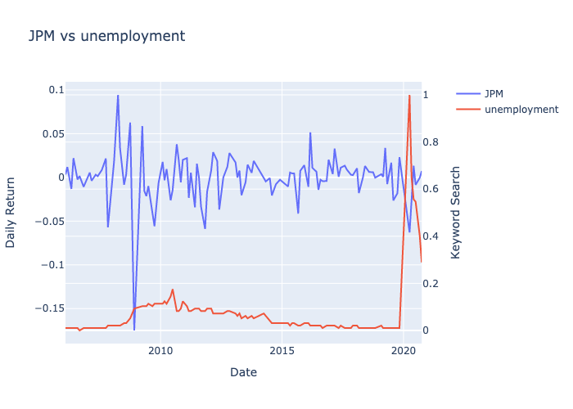
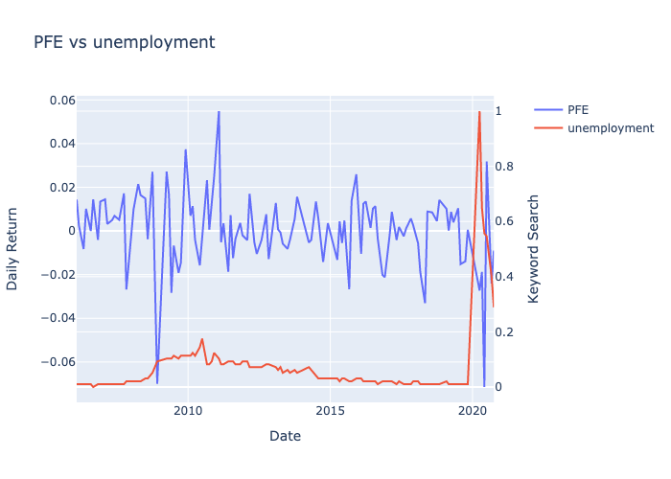
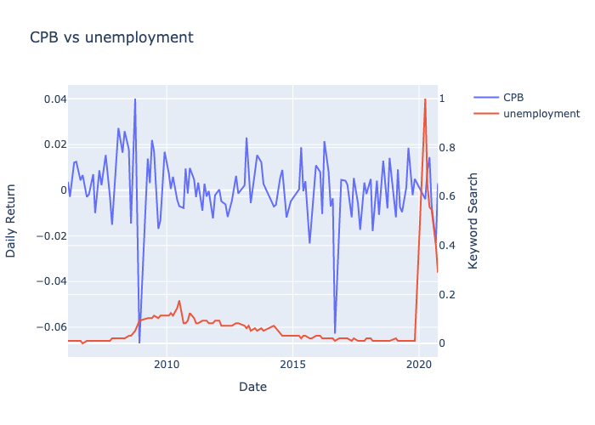
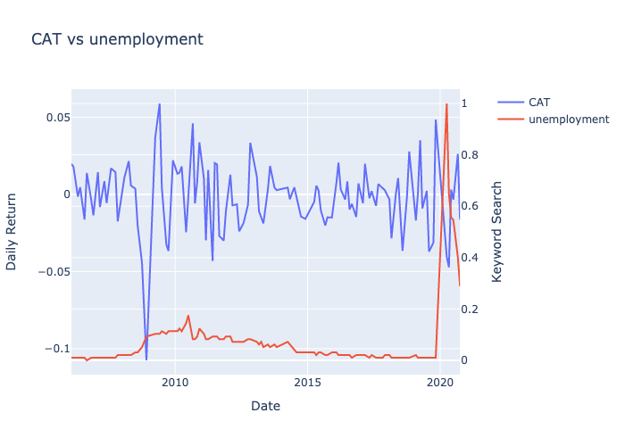
Data Analysis: Unemployment vs Stocks

Slide 24
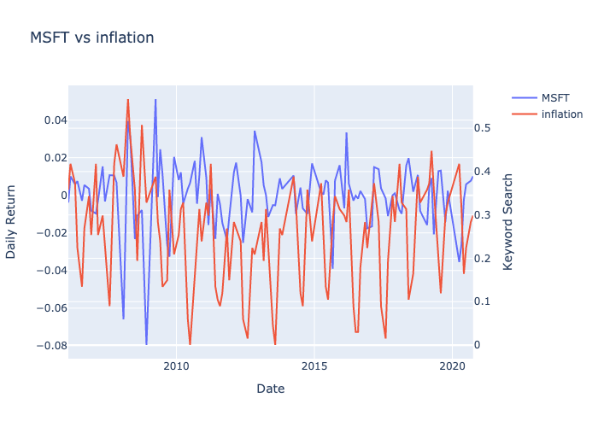
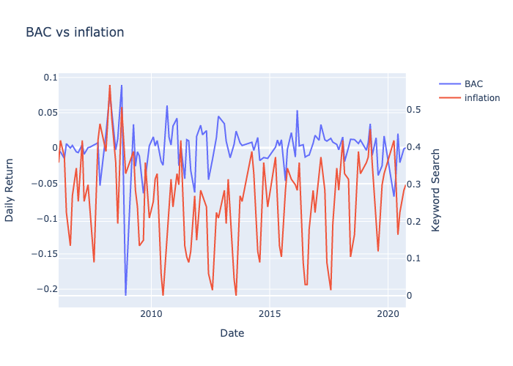
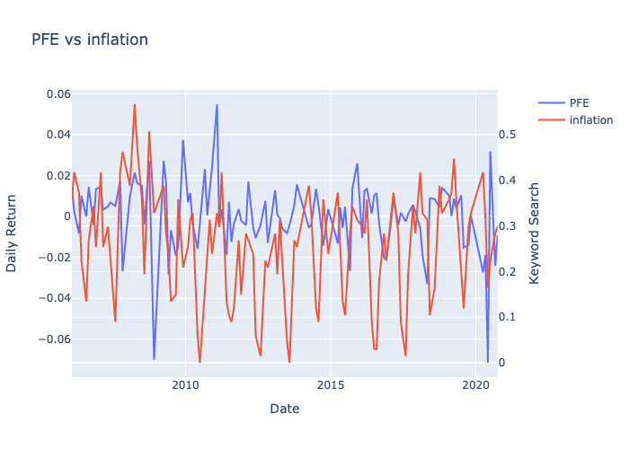
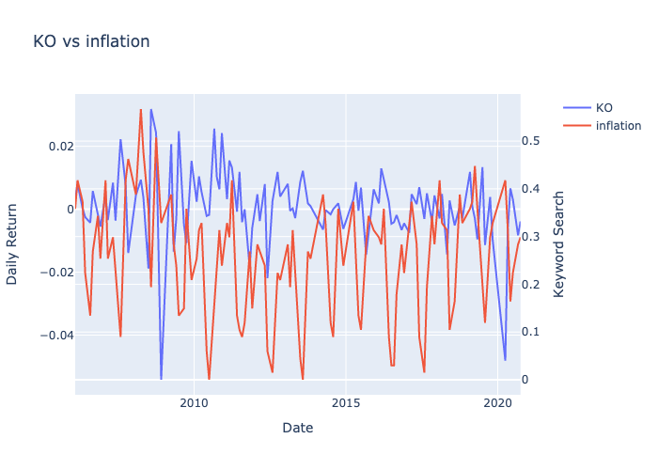
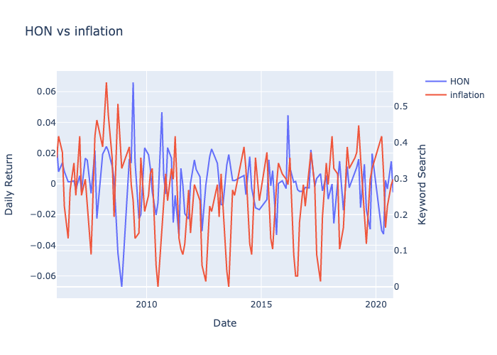
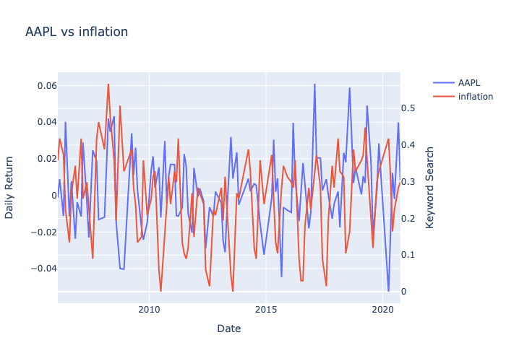
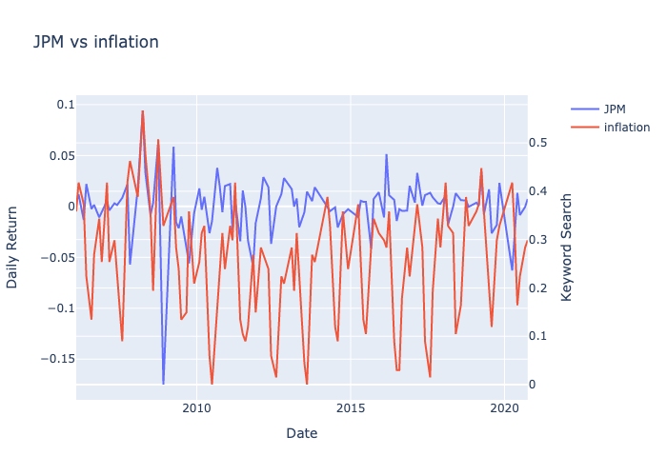
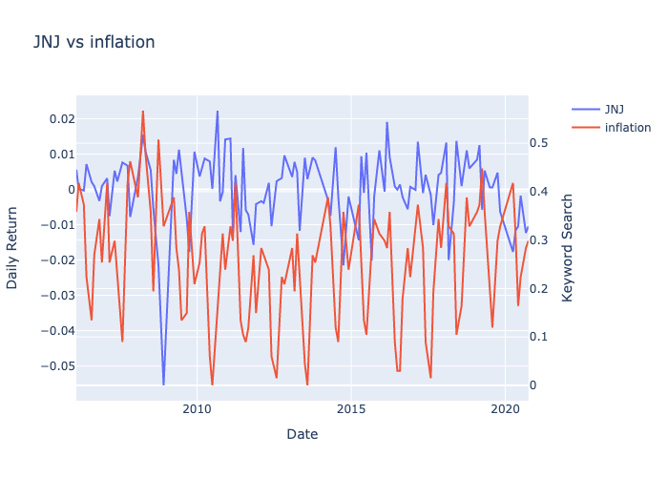
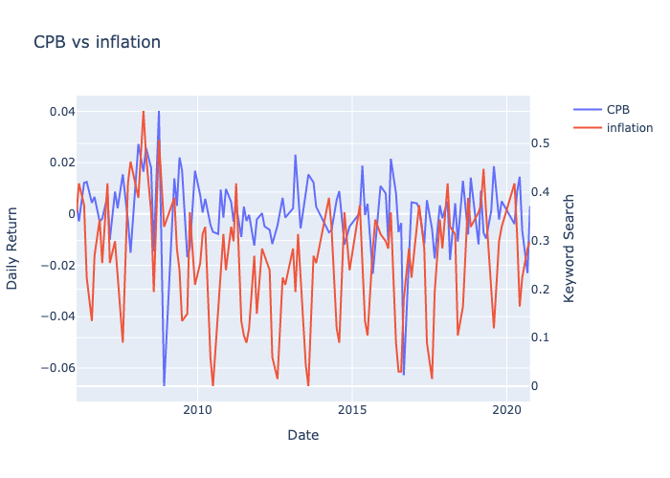
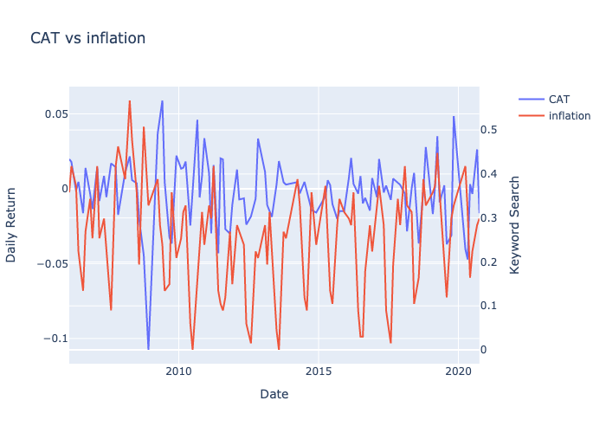
Data Analysis: Inflation vs Stocks

Slide 25
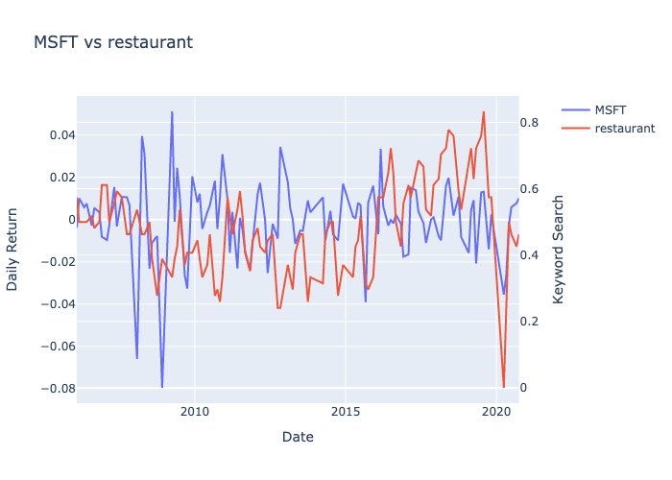
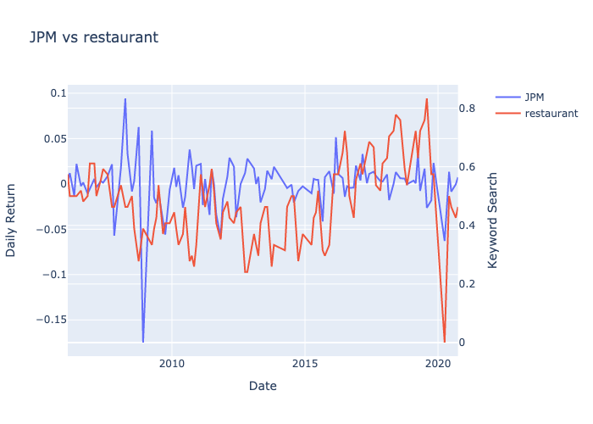
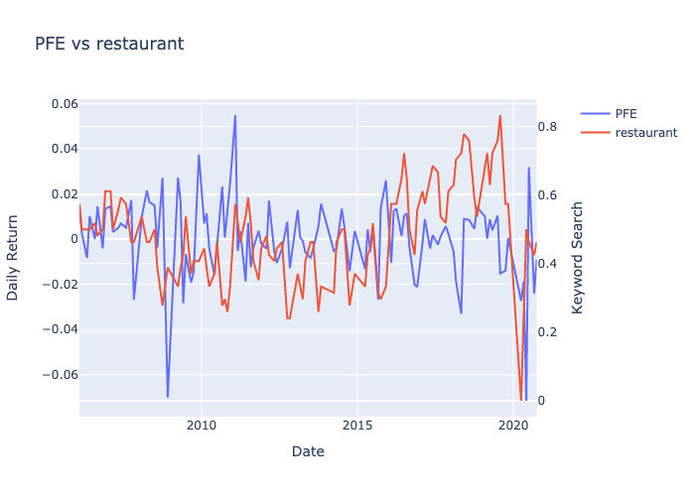
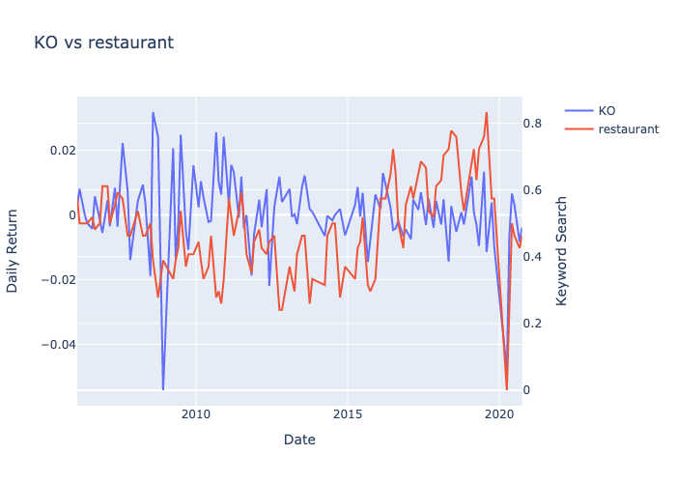
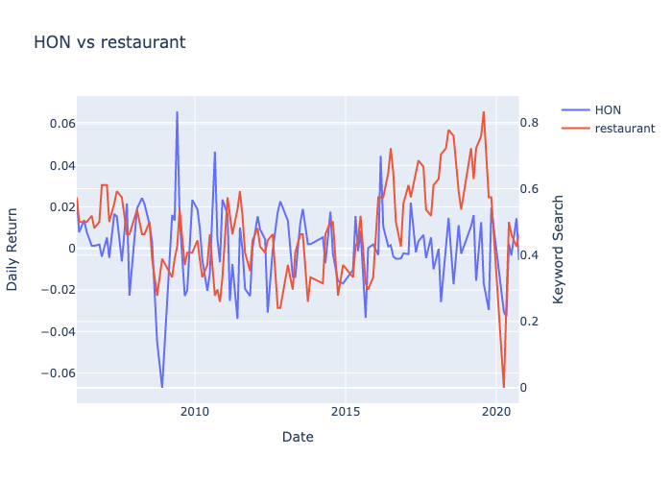
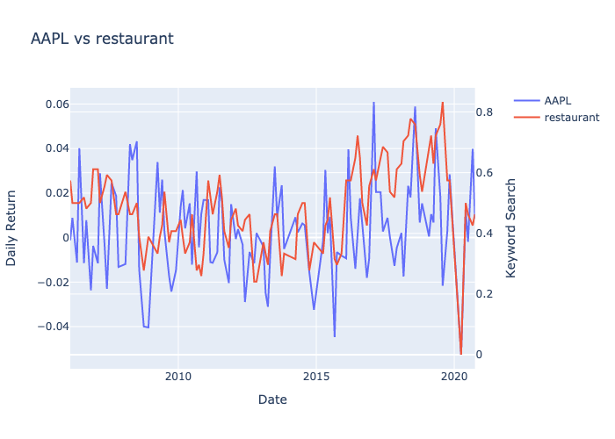
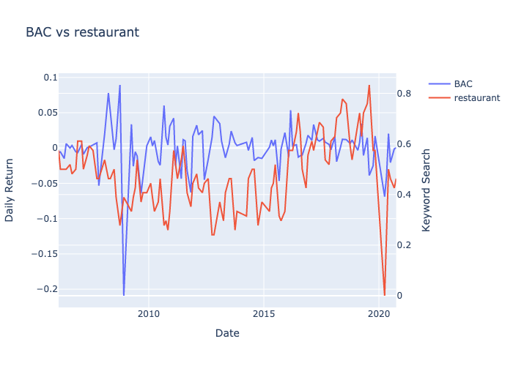
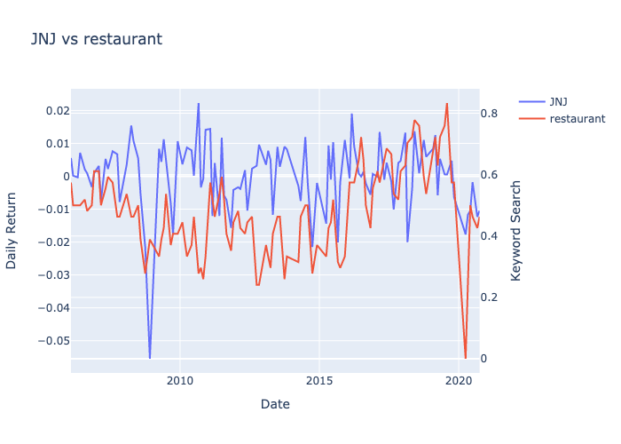
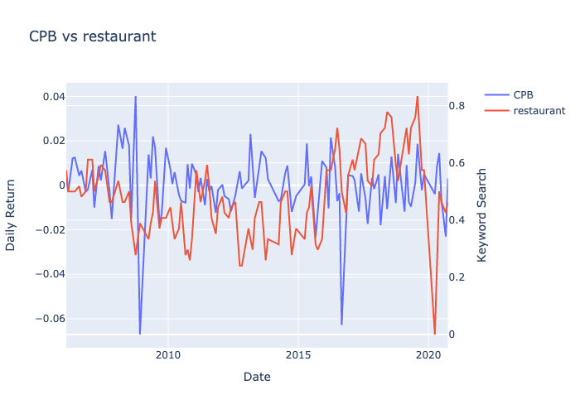
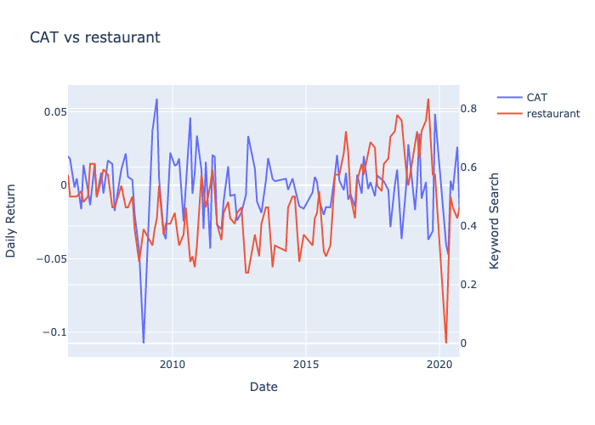
Data Analysis: Restaurant vs Stocks

